Slide 1
BASIC GRAPHICAL USER INTERFACE
Basic GUI Components

Slide 2
Agenda
Agenda
Basic GUI Programming Concepts
Graphical User Interface (GUI)
Simple GUI-based Input/Output
JFrame, JPanel & JLabel
Using Layout Managers
Custom Painting
Graphics
Reading
Java how to program Late objects version (D & D)
Chapter 12
The Java Tutorial:
Getting started with Swing:
https://docs.oracle.com/javase/tutorial/uiswing/start/index.html
Using Swing Components
https://docs.oracle.com/javase/tutorial/uiswing/components/index.html
Custom painting
https://docs.oracle.com/javase/tutorial/uiswing/painting/step2.html

Slide 3
1.Basic GUI Programming Concepts
A graphical user interface (GUI) presents a user-friendly mechanism for interacting with an application.
Pronounced “GOO-ee”
Gives an application a distinctive “look-and-feel.”
Conventional programming:
sequence of operations is determined by the program
what you want to happen, happens when you want it
Event-driven programming:
sequence of operations is determined by the user’s interaction with the application’s interface
anything that can happen, happens at any time
output
Application
input
GUI-based
Application
draw
callbacks
Widgets
output
input
The User

Slide 4
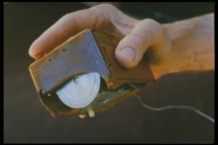
1.Basic GUI Programming Concepts History of Graphical User Interfaces (GUIs)
In the beginning was the Command Line Interface (CLI)
The first GUI was developed at Xerox PARC in the early 70s.
Desktop metaphor, mouse & keyboard, windows, menus, buttons, …
Xerox Alto (1973-), Star (1981-).
Not a commercial success, but is the basis for all subsequent GUIs.
First commercially-successful GUI on personal computers:
Apple Macintosh (1984-).
1960s mouse
(Engelbart)
The X Window System (version 11, released 1987) ran on many platforms including Unix workstations, PCs, Macs.
“… an architecture-independent system for remote graphical user interfaces and input device capabilities.
“Each person using a networked terminal has the ability to interact with the display with any type of user input device.” [Wikipedia]
Windows 3.0 (1990-)
This was Microsoft’s first successful GUI-based OS.

Slide 5
2.Graphical User Interface (GUI) Implementing GUIs in Java
The Java Foundation Classes (JFC) are a set of packages encompassing the following APIs:
AWT – Abstract Windows Toolkit (java.awt package)
The older version of the components
Rely on “peer architecture”…drawing done by the OS platform on which the application/applet is running
Considered to be “heavy-weight” components using native GUI system elements
Swing (Java 2, JDK 1.2+) (javax.swing package)
Newer version of the components
No “peer architecture”…components draw themselves
Most are considered to be “lightweight” that do not rely on the native GUI or OS

Slide 6
2.Graphical User Interface (GUI) AWT & SWING
Abstract Windows Toolkit
Provides basic UI components:
Buttons, lists, menus, textfields, etc
Event handling mechanism
Organize components using layout managers
SWING
A newer library written from the ground up that allows much more powerful graphics and GUI construction
Swing component names begin with ``J'':
Component (AWT) vs. JComponent (Swing)
Always use Swing components; however, since Swing is built on top of AWT, you will need to know some AWT methods

Slide 7

2.Graphical User Interface (GUI) GUI elements
windows: actual first-class citizens of desktop; also called top-level containers examples: frame, dialog box
components: GUI widgets examples: button, text box, label
containers: logical grouping for components example: panel

Slide 8
2.Graphical User Interface (GUI) Swing component hierarchy
java.lang.Object
+--java.awt.Component
+--java.awt.Container
|
+--javax.swing.JComponent
| +--javax.swing.JButton
| +--javax.swing.JLabel
| +--javax.swing.JMenuBar
| +--javax.swing.JOptionPane
| +--javax.swing.JPanel
| +--javax.swing.JTextArea
| +--javax.swing.JTextField
|
+--java.awt.Window
+--java.awt.Frame
+--javax.swing.JFrame

Slide 9
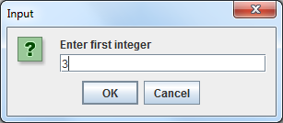
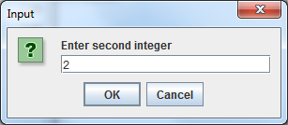
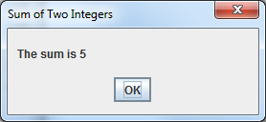
3.Simple GUI-based Input/Output Using JOptionPane
Most applications use windows or dialog boxes (also called dialogs) to interact with the user.
JOptionPane (package javax.swing) provides prebuilt dialog boxes for input and output (note: the user cannot interact with the rest of the application while dialog is displayed.)
Displayed via static JOptionPane methods.
For example, we use two input dialogs to obtain integers from the user and a message dialog to display the sum of the integers the user enters.
String num1 = JOptionPane.showInputDialog("Enter first integer");
String num2 = JOptionPane.showInputDialog("Enter second integer");
int sum = Integer.parseInt(num1) + Integer.parseInt(num2);
JOptionPane.showMessageDialog(null, "The sum is " + sum,
"Sum of Two Integers", JOptionPane.PLAIN_MESSAGE);

Slide 10
3.Simple GUI-based Input/Output showInputDialog
showInputDialog static method
displays an input dialog, using the method’s String argument as a prompt.
The user types characters in the text field, then clicks OK or presses the Enter key to submit the String to the program.
Can input only Strings. (Typical of most GUI components)
If the user clicks Cancel, returns null.
showMessageDialog static method
displays a message dialog.
The first argument helps determine where to position the dialog.
If null, the dialog box is displayed at the center of your screen.
The second argument is the message to display.
The third argument is the String that should appear in the title bar at the top of the dialog.
The fourth argument is the type of message dialog to display.
PLAIN_MESSAGE dialog does not display an icon to the left of the message.

Slide 11
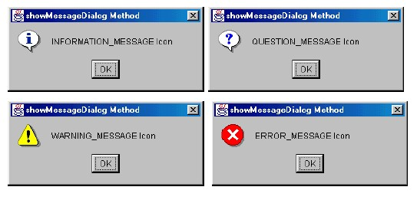
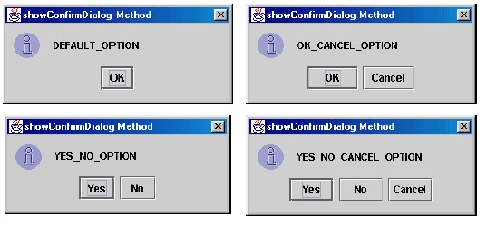
3.Simple GUI-based Input/Output JDialog Boxes
showMessageDialog
Icons, messages and OK buttons
showConfirmDialog
Asks a confirming question (yes/no/cancel)
Icons, messages and buttons: OK, OK/Cancel, Yes/No, Yes/No/Cancel
JOptionPane.showMessageDialog(frame, "Message", "Title", JOptionPane.ERROR_MESSAGE);
JOptionPane.showConfirmDialog(frame, "Message", "Title", JOptionPane.YES_NO_OPTION);

Slide 12
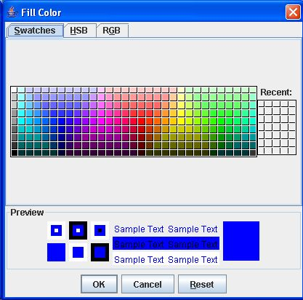
3.Simple GUI-based Input/Output JColorChooser
JColorChooser provides a pane of controls designed to allow a user to manipulate and select a color.
showDialog static method:
Arguments: parent component, title string, initially selected colour
The user selects a colour and clicks OK submit the selected colour to the program.
If the user clicks Cancel, returns null.
Color newColor = JColorChooser.showDialog(null, "Fill Color", Color.blue);
JOptionPane.showMessageDialog(null, "The sum is " + newColor,
"Selected Color", JOptionPane.PLAIN_MESSAGE);

Slide 13
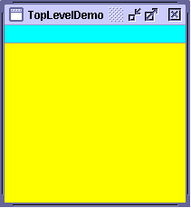
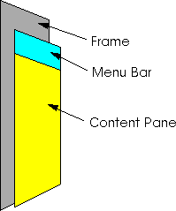
4.JFrame, JPanel & JLabel JFrame - is a Window, a Container
A frame is a graphical window that can be used to hold other components.
A JFrame object is a window with a border and a title bar.
The visible area of a JFrame object is a Container which means that we will be able to add components, such as a JPanel object, to the JFrame object.
Note: components are added to the top of a lightweight AWT Container – it is called the content pane.
Most windows that can contain Swing GUI components are instances of class JFrame or a subclass of JFrame.
JLabel:
A text label is simply a string of text displayed on screen in a graphical program. Labels often give information or describe other components
getContentPane().add(emptyLabel);

Slide 14
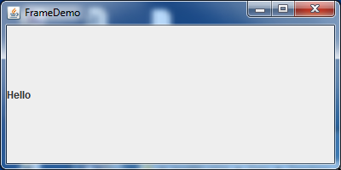
4.JFrame, JPanel & JLabel JFrame
Four Important Steps:
Adding components:
setDefaultCloseOperation:
indicates that the program should terminate when the window is closed by the user.
setSize/pack:
setSize: specifies the width and height of the window in pixels.
Pack: resize the frame to fit the components inside it.
setVisible:
with the argument true displays the window on the screen.
JFrame frame = new JFrame();
frame.setDefaultCloseOperation(JFrame.EXIT_ON_CLOSE);
JLabel emptyLabel = new JLabel("Hello");
frame.getContentPane().add(emptyLabel);
frame.setSize(400, 200);
frame.setVisible(true);

Slide 15
4.JFrame, JPanel & JLabel JPanel
You can use “new JPanel()” to create a panel for grouping components into a container, which can then be added to another container
Use the add(Component) method to add a component to the panel.
It is also a dedicated drawing area
Override this method to specify how to draw.
Call the superclass version of paintComponent as the first statement in the body of the overridden method to ensure that the component displays correctly.
JPanel p = new JPanel();
p.add(new JButton("OK"));

Slide 16
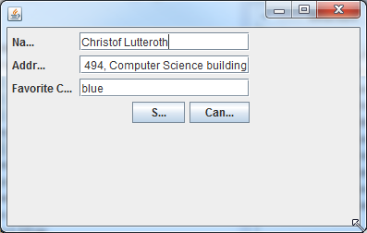
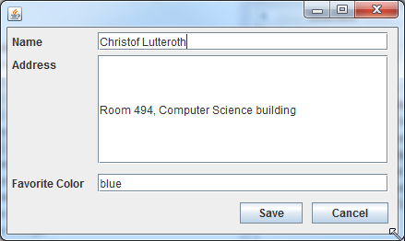
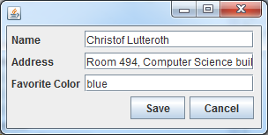
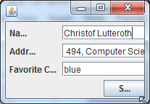
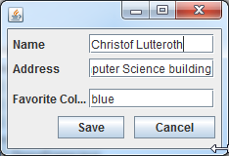
5.Using Layout Managers
Layout managers arrange GUI components in a container for presentation purposes
Get a layout specification as input
Recalculate the positions and sizes of the child widgets after each container resizing
Support for resizing, different screens, possibly even different devices
Original
Resizing without Layout Manager
Resizing with Layout Manager

Slide 17
5.Using Layout Managers Creating
It implements the LayoutManager interface
Select the layout manager by setting the layout property
Specify layout with extra parameters when adding widgets to your GUI, e.g.
Container pane = getContentPane();
pane.setLayout(new FlowLayout());
pane.add(button1, BorderLayout.PAGE_START);
Component
Container
setLayout( mgr : LayoutManager ) : void
doLayout( )
add( c : Component ) : void
<< interface >>
LayoutManager
layoutContainer( c : Container )
minimumLayoutSize( c : Container ) : Dimension
preferredLayoutSize( c : Container ) : Dimension
BorderLayout
BoxLayout
FlowLayout
GridLayout

Slide 18
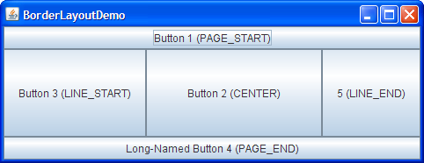
5.Using Layout Managers BorderLayout
BorderLayoutDemo.java
Places components in up to five areas: top, bottom, left, right, and center
These areas are specified by the BorderLayout constants:
PAGE_START
PAGE_END
LINE_START
LINE_END
CENTER
All extra space is placed in the center area
Fairly easy to use, but very limited
Note: alternate ways of writing:
add(component, BorderLayout.CENTER) //preferred
add(BorderLayout.CENTER, component) //valid but old fashioned or
add("Center", component) //valid but error prone
Container pane = getContentPane();
pane.setLayout(new BorderLayout());
JButton button = new JButton("Button 1 (PAGE_START)");
pane.add(button, BorderLayout.PAGE_START);
button = new JButton("Button 3 (LINE_START)");
pane.add(button, BorderLayout.LINE_START);
...

Slide 19
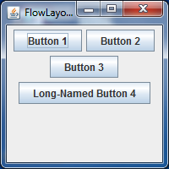
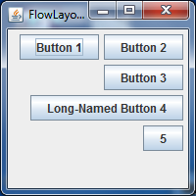
5.Using Layout Managers FlowLayout
FlowLayoutDemo.java
Place components in a row, sized at their preferred size.
Arranges widgets over several lines from left-to-right, with top-to-bottom line breaks, just like text
When the edge of the container is reached, components continue to display on the next line.
Default for JPanel
Constructors:
Default constructor:
centered alignment and horizontal and vertical gaps – 5 pixels
FlowLayout(int align) - indicated alignment
FlowLayout.RIGHT, FlowLayout.LEFT etc
Container p = getContentPane();
p.setLayout(new FlowLayout(FlowLayout.RIGHT));
p.add(new JButton("Button 1"));
p.add(new JButton("Button 2"));
p.add(new JButton("Button 3"));
p.add(new JButton("Long-Named Button 4"));
p.add(new JButton("5"));

Slide 20
6.Custom Painting
Create an area for custom painting/drawing inside a JPanel
Override the paintComponent method
Note: Call the superclass version of paintComponent as the first statement in the body of the overridden method to ensure that the component displays correctly.
Note: We don’t make a direct call to the paintComponent() method in our code.
This method is called automatically by the Java runtime whenever the JPanel area needs to be refreshed e.g.
when the JFrame is first created and displayed,
on some platforms the JPanel area is covered (the user moves to another application) and comes back to the JFrame,
when the user makes a change to the JFrame size.
public void paintComponent(Graphics g) {
super.paintComponent(g);

Slide 21
6.Custom Painting Example
Note:
The Graphics object is supplied by the Java runtime to the paintComponent() method whenever the JPanel object needs to be displayed.
Inside the paintComponent() method the Graphics object can be used to draw things.
super.paintComponent() is always the first statement of the paintComponent() method. This statement ensures that the JPanel area is cleared before any painting is done.
class MyPanel extends JPanel {
...
public void paintComponent(Graphics g) {
super.paintComponent(g);
g.drawString("This is my custom Panel!",10,20);
}
}

Slide 22
6.Custom Painting Graphics & Graphics2D
Old graphics context: java.awt.Graphics
Used in Java 1.0 and 1.1, now obsolete
New graphics context: java.awt.Graphics2D
Part of Java 2D (in Java 1.2 and later)
Although paintComponent() takes a Graphics object, what you get is really a Graphics2D!
Basic methods for painting (Graphics and Graphics2D):
drawLine()
clearRect(), drawRect(), draw3DRect(), fillRect(), fill3DRect()
drawArc(), fillArc(), drawOval(), fillOval()
drawPolygon(), fillPolygon(), drawPolyLine()
drawString()
public void paintComponent(final Graphics g) { ...
final Graphics2D g2d = (Graphics2D) g; // Just cast it…
// Use g2d
}

Slide 23
6.Custom Painting Java 2D
Support for arbitrary shapes
A single draw() method, a single fill()
Draws or fills anything implementing
Line2D, Rectangle2D, RoundRectangle2D
Arc2D, Ellipse2D
QuadCurve2D, CubicCurve2D
...
Pen styles implement the Stroke interface (BasicStroke)
Different line widths, patterns, join styles
Use setStroke()
Fill patterns implement the Paint interface
Color: Solid fill, default color space sRGB (rgb + alpha)
Color.RED, Color.GREEN, Color.BLACK, ...
TexturePaint: Tiles a picture (repeats as necessary)
GradientPaint: A gradient between two colors
Use setPaint() or the older setColor()
Color cyan2 = new Color(0, 255, 255); // Between 0 and 255

Slide 24
6.Custom Painting Drawing Shapes
In order to draw in the JPanel area we use the Graphics object. The Graphics object is supplied by the Java runtime as a parameter to the paintComponent() method. The Graphics class contains many instance methods:
drawLine(int x1, int y1, int x2 , int y2)
drawRect(int x, int y, int width, int height)
drawOval(int x, int y, int width, int height)
fillRect(int x, int y, int width, int height)
fillOval(int x, int y, int width, int height)
drawString(String text, int x, int y)
setColor(Color color)
g.setColor(Color.YELLOW);

Slide 25
Exercise 1
Draws the following JPanel. All the shapes are drawn in black.
Inner circle has top, left position: 20,10 and size: 60
Outer circle is 8 pixels wider than the inner circle
Filled square has top, left position: 35,25 and size: 30
Text is at position: 84,40

Slide 26
Exercise 2
Draws the following JPanel. All the shapes are drawn in black.
public void paintComponent(Graphics g) {
super.paintComponent(g);
drawLogo(g, 20, 30, 10);
drawLogo(g, 80, 30, 20);
drawLogo(g, 60, 100, 30);
}

